Slide 1

Visualize your research! Learn how to build, deploy, and implement interactive online dashboards to increase protocol adherence, monitor patient-reported outcomes (PROs), and inform clinical decision making.
Michael A. Golafshar M.S., Molly Voss, Todd A. DeWees PhD
Notes:
Utilize the R prog lang to build interactive quality of life reports

Slide 2

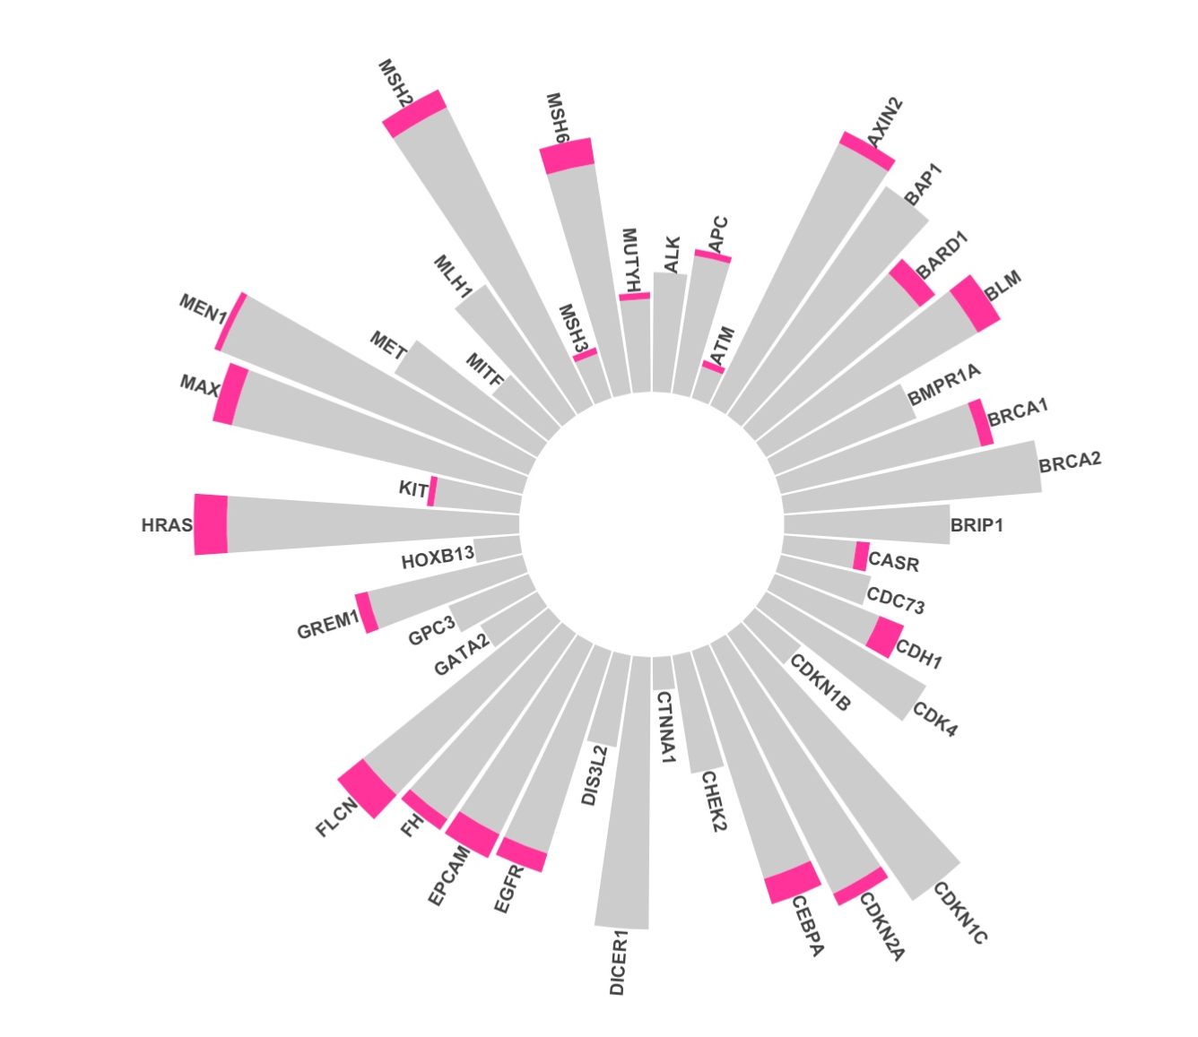
Welcome / Session Outline
Get set up
Get to know RStudio
Basic R scripts
Build a sample dashboard
Next steps
Notes:
best way to handle missing data is to stop it from being missing.

Slide 3
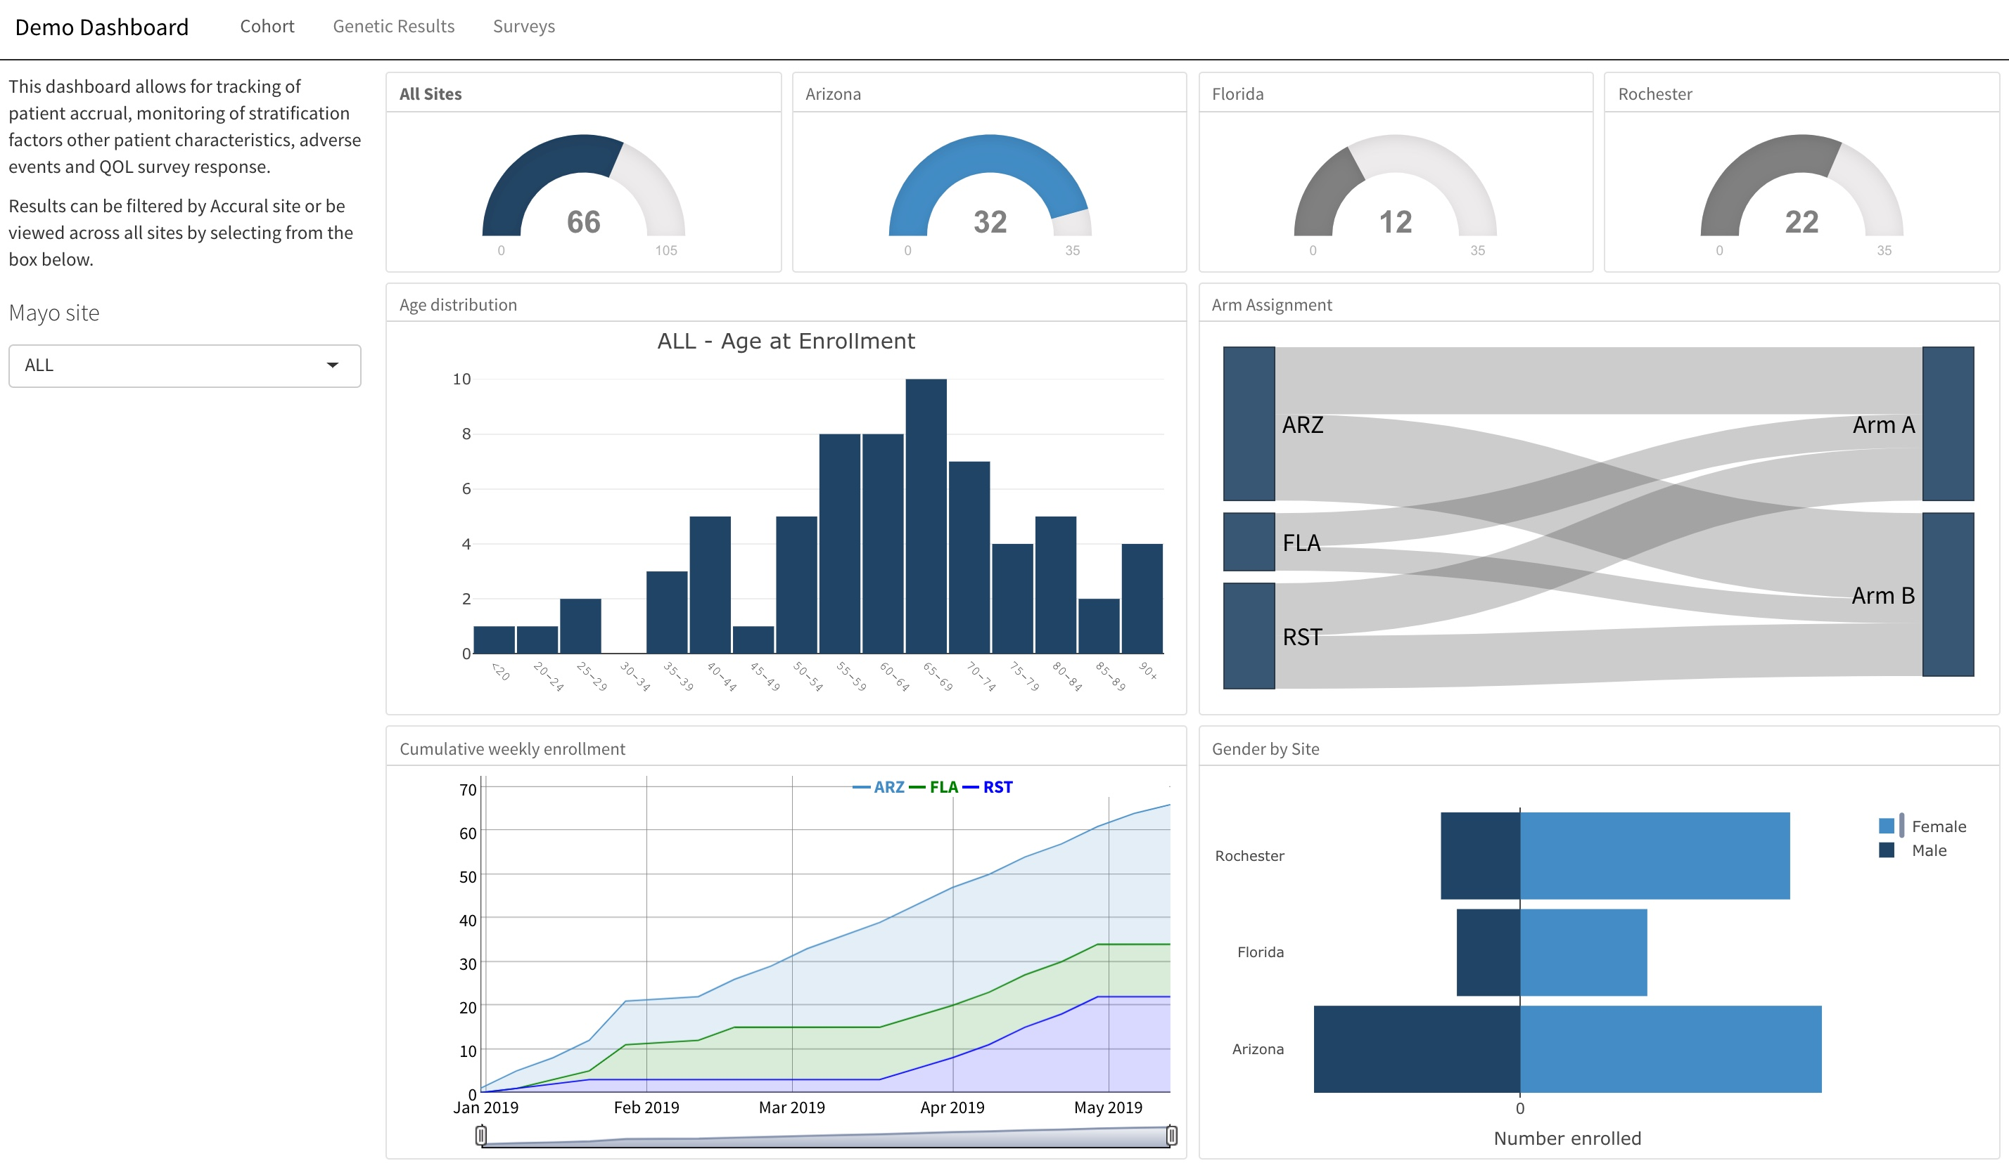
Why Create Dashboards?
All of your data is on demand
Less time spent on one-time reports
One stop shop for all study members to get all of the information they need.
Notes:
On Demand
With this data at our fingertips we can grab patients as they come in for visits
Which leads to increased protocol adherence
-by keeping investigators and CRCs up to date on potentially missing data
Who doesn’t want a dashboard
Issues – perception that it will take a long time and or cost a lot of money
- The focus of the remainder of this talk

Slide 4
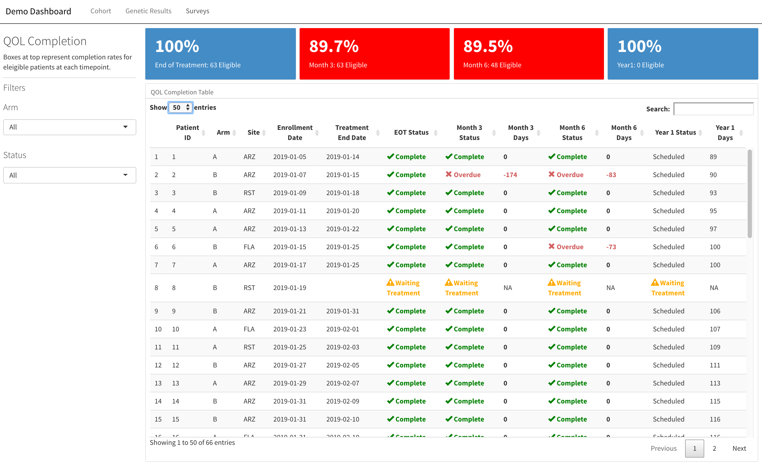
Why Create Dashboards?
Allows for real-time quality control
Relatively inexpensive
Not as difficult as it might seem
Notes:
On Demand
With this data at our fingertips we can grab patients as they come in for visits
Which leads to increased protocol adherence
-by keeping investigators and CRCs up to date on potentially missing data
Who doesn’t want a dashboard
Issues – perception that it will take a long time and or cost a lot of money
- The focus of the remainder of this talk

Slide 5
Getting Set Up - Tools
R
RMarkdown
Flexdashboard
Shiny
-- FREE
-- FREE
-- FREE
-- JK! It’s FREE
-- $25,000
Notes:
R
- Programming language developed by statisticians
- Grown tremendously over the las 10 years
- very lively user base
Rmarkdown
- R’s implementation of markdown language
-used for applying inline style to text primarily for publishing to the web
Flexdashboard
- library created by the RStudio team.
- provides structure by borrowing elements from RMarkdown
Shiny
Allows you to embed reactive elements in the dashboard
not necessary if you don't want to filter / sort ,etc.

Slide 6

Getting Set Up - Tools
Github
Sample code
Sample data
data <- read.csv("https://raw.githubusercontent.com/mgolafshar/clinical-dashboards/master/data/mock_cohort.csv")
Notes:
R
- Programming language developed by statisticians
- Grown tremendously over the las 10 years
- very lively user base
Rmarkdown
- R’s implementation of markdown language
-used for applying inline style to text primarily for publishing to the web
Flexdashboard
- library created by the RStudio team.
- provides structure by borrowing elements from RMarkdown
Shiny
Allows you to embed reactive elements in the dashboard
not necessary if you don't want to filter / sort ,etc.

Slide 7
Getting Set Up – Download Tools
Download will differ if you have a Mac vs. Windows system.
You must download and install both RStudio and R to use RStudio
Instructions and links for all users.
Download R : R's instructions on download and set-up
Choose the right option (Mac, Windows, Linux) Download
Choose base
Download -> Open the download -> Choose the location -> Install
RStudio Download : Use the RStudio Desktop but you could probably use the browser option as well
MAC USERS DO NOT USE THE BIG BLUE BOTTON
Choose the right option (Mac, Windows, Linux) Download
Download -> Open the download -> Choose the location -> Install
Open the application and use R64
Notes:
best way to handle missing data is to stop it from being missing.

Slide 8
RStudio
“RStudio is an application like Microsoft Word- except that instead of helping you write in English, Rstudio helps you write in R.” And we will use it because it looks the same across all users (Windows vs. mac) and it is FREE
How to navigate the Rstudio interface.
3 window panes (console, environment, viewer)
Opening a script and editing it
Running a command (console and terminal)
Want to know basic more R that we may not cover? Here are some good options.
R-Studio-Basics
Notes:
best way to handle missing data is to stop it from being missing.

Slide 9
Basic R Commands
It is a calculator!
Assigning elements
Vectors
Functions
Sum, log
Packages
How to install
Here are all the packages you need for the demonstration
Data structure (mtcars)
Viewing
Summary
Subset
Notes:
best way to handle missing data is to stop it from being missing.

Slide 10
Reading in Data in R and Summarizing
Reading in data
Functions based on file type
Ex: read.csv, readRDS, read.xlsx
REDCap API
Building basic tables
Summaries in base R and DT
Visual aids
Base R graphics (hist, boxplot)
ggplot
plotly
Notes:
best way to handle missing data is to stop it from being missing.

Slide 11
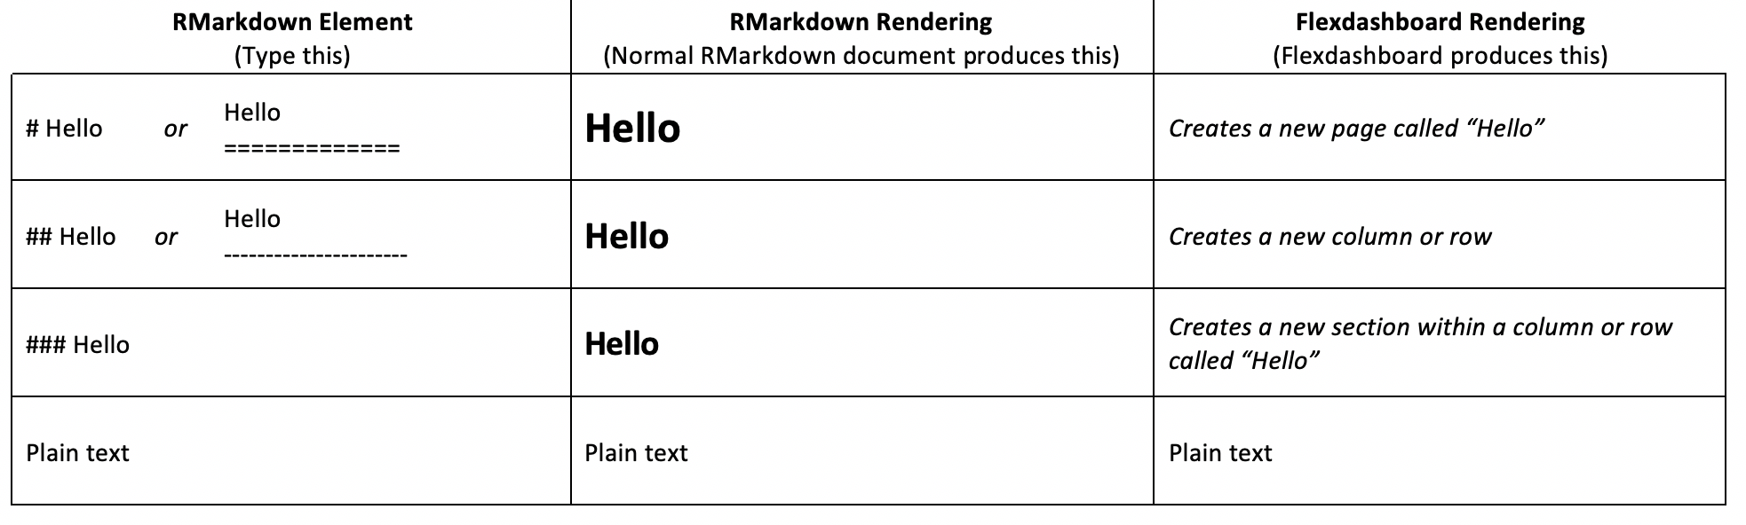
RMarkdown
RMarkdown : allows you to easily create reports and seamlessly combine text and code together in a single document. This helps with reproducibility.
YAML Markdown Code
Syntex
Code chuck
Options (results, echo, include)
How to knit
Flexdashboard
Uses RMarkdown to create dashboard
Most be row or column format
Anatomy and basic example
Notes:
best way to handle missing data is to stop it from being missing.

Slide 12
Anatomy of a Flexdashboard
---
title: “Demo Dashboard”
output: flexdashboard::flex_dashboard
---
Page 1
==================================
Column
-------------------------------------------------------
### Plot A
```{r}
CODE GOES HERE
```
YAML
Notes:
.
YAML – title and directions on how the document should be rendered

Slide 13
Anatomy of a Dashboard
---
title: “Demo Dashboard”
output: flexdashboard::flex_dashboard
---
Page 1
==================================
Column
-------------------------------------------------------
### Plot A
```{r}
CODE GOES HERE
```
RMarkdown
Notes:
.

Slide 14
Anatomy of a Dashboard
---
title: “Demo Dashboard”
output: flexdashboard::flex_dashboard
---
Page 1
==================================
Column
-------------------------------------------------------
### Plot A
```{r}
CODE GOES HERE
```
Code block
Notes:
.

Slide 15
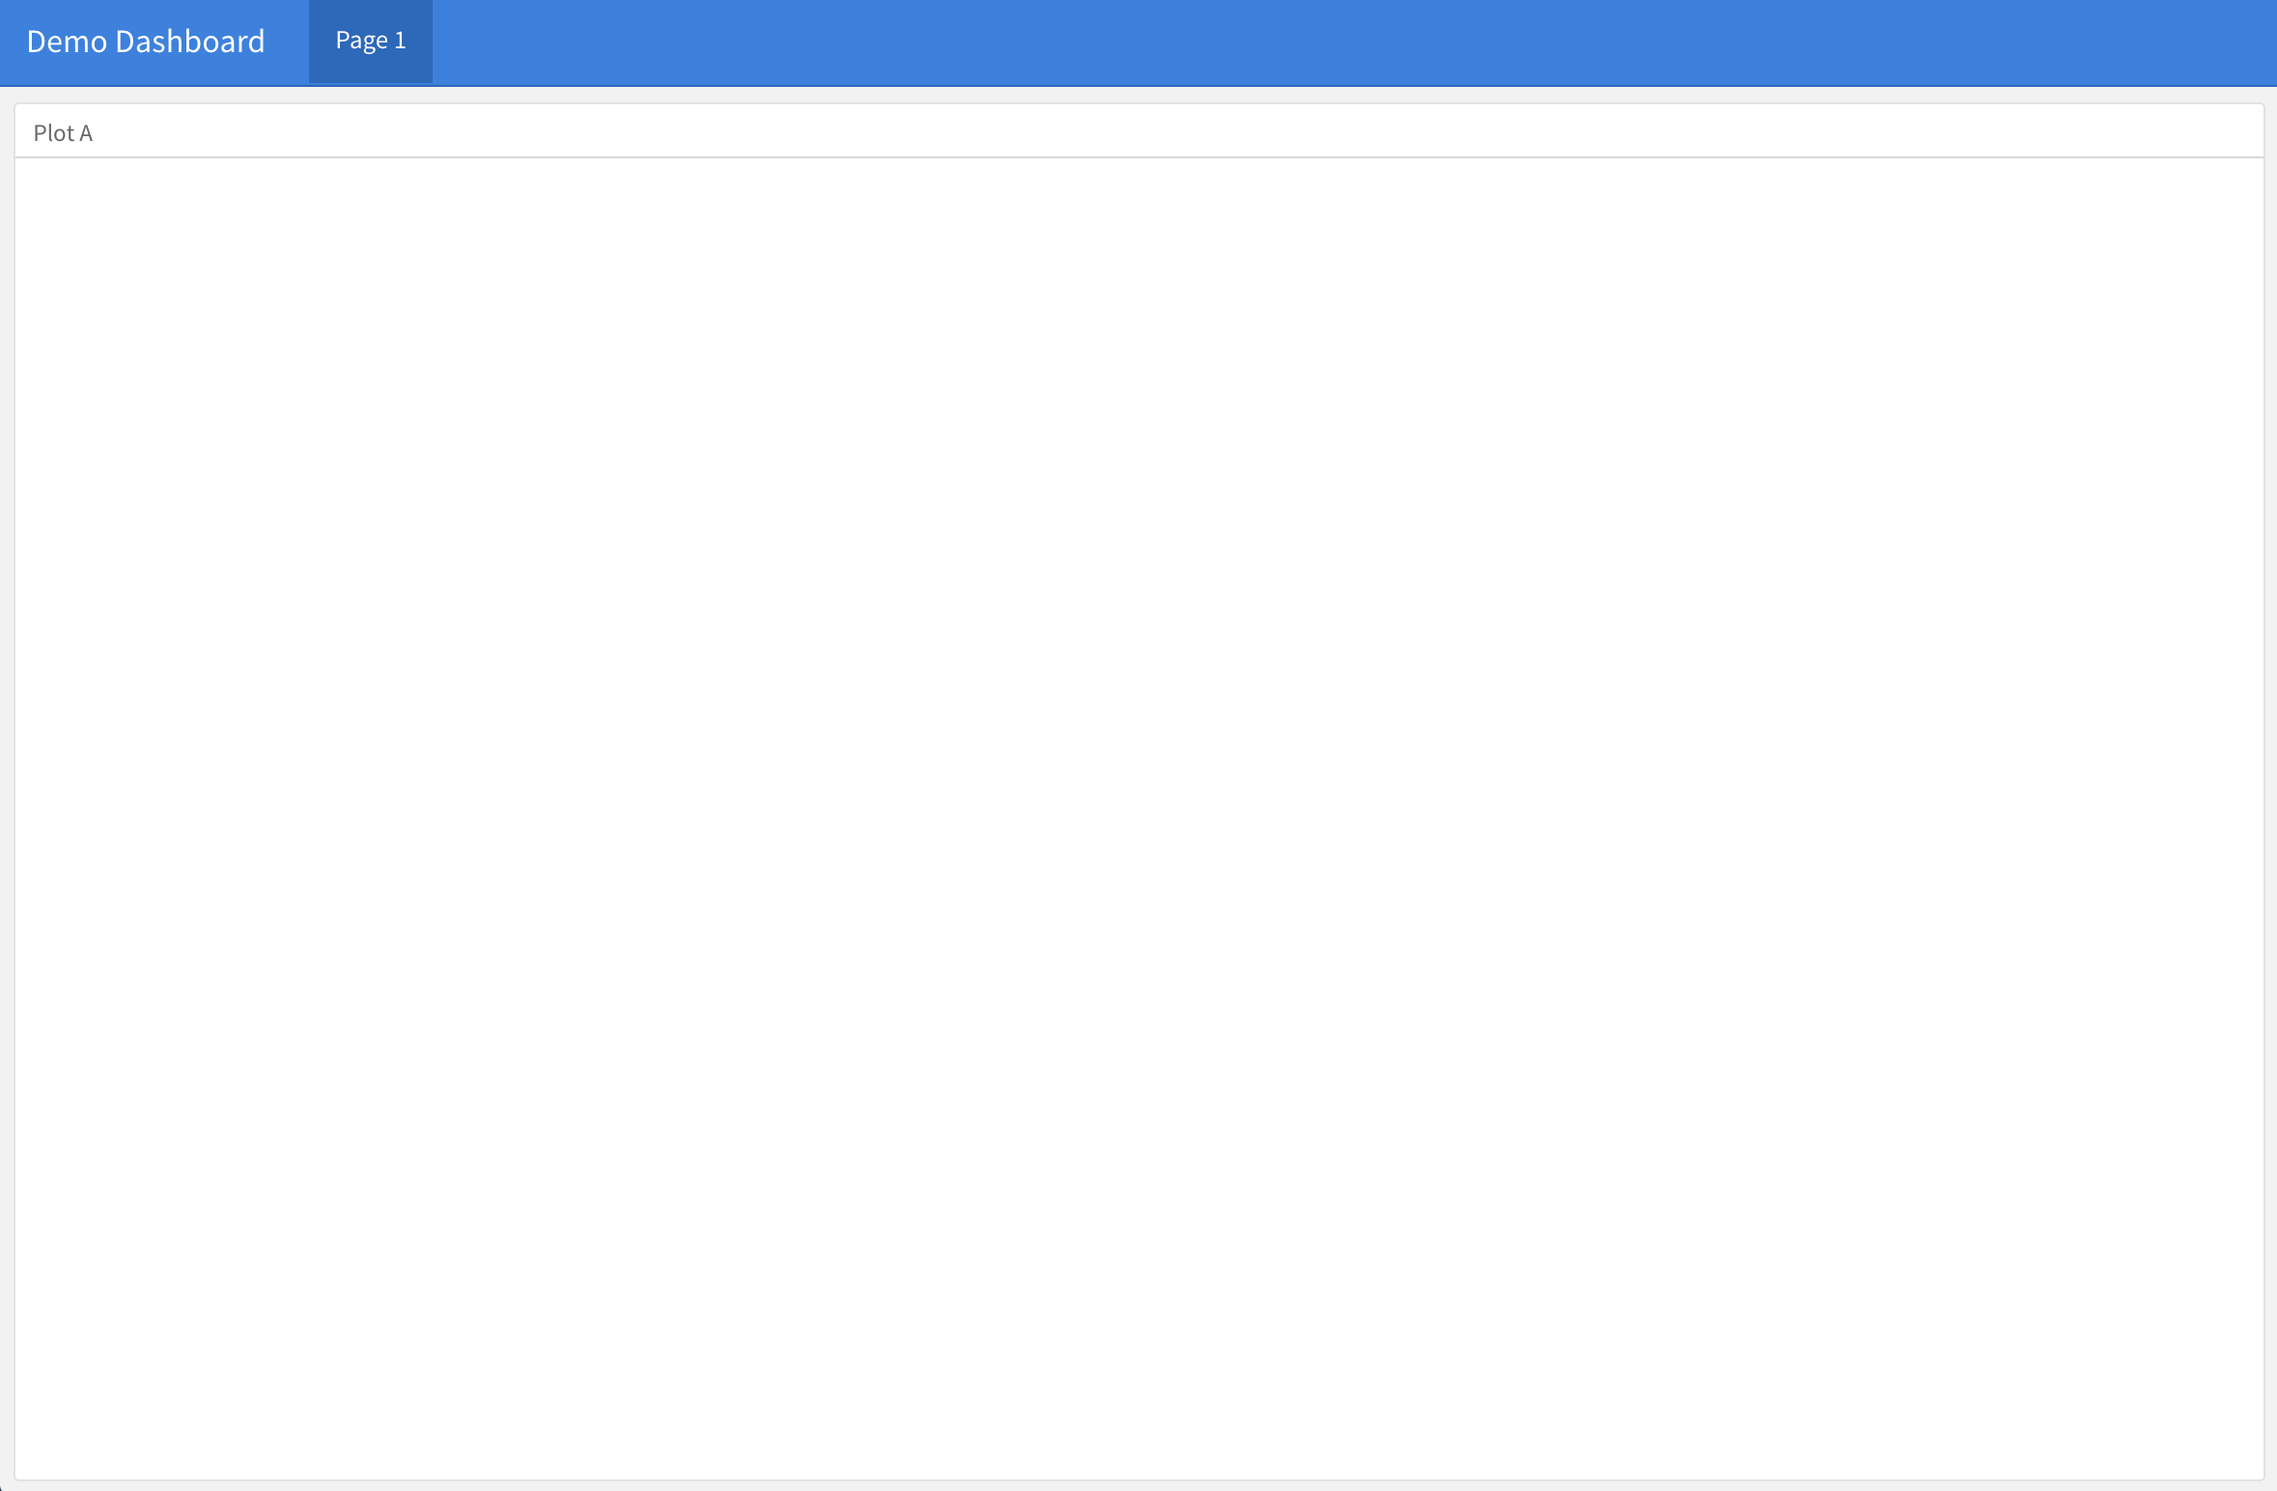

Slide 16
Constructing a Dashboard
---
title: ”Demo Dashboard"
output: flexdashboard::flex_dashboard
---
Page 1
==================================
Column {data-width=650}
-------------------------------------------------------
### Plot A
```{r}
CODE GOES HERE
```
Page 2
==================================
Let’s add a new page...
Page 2
==================================

Slide 17
Constructing a Dashboard
---
title: ”Demo Dashboard"
output: flexdashboard::flex_dashboard
---
Page 1
==================================
Column {data-width=650}
-------------------------------------------------------
### Plot A
```{r}
CODE GOES HERE
```
Surveys
==================================
with a more meaningful name.
Surveys
==================================

Slide 18
Constructing a Dashboard
---
title: ”Demo Dashboard"
output: flexdashboard::flex_dashboard
---
Demographics
==================================
Column {data-width=650}
-------------------------------------------------------
### Plot A
```{r}
CODE GOES HERE
```
Surveys
==================================
Rename the first tab.
Demographics
==================================

Slide 19
Constructing a Dashboard
---
title: ”Demo Dashboard"
output: flexdashboard::flex_dashboard
---
Demographics
==================================
Inputs {.sidebar }
-----------------------------------
Column {data-width=650}
-------------------------------------------------------
### Plot A
```{r}
CODE GOES HERE
```
Surveys
==================================
Add a sidebar...
Inputs {.sidebar }
---------------------------------

Slide 20
Constructing a Dashboard
---
title: ”Demo Dashboard"
output: flexdashboard::flex_dashboard
---
Demographics
==================================
Inputs {.sidebar }
---------------------------------
## Hello
I am some text in the sidebar.
Column {data-width=650}
-------------------------------------------------------
### Plot A
```{r}
CODE GOES HERE
```
Surveys
==================================
Add a sidebar... with text.
Inputs {.sidebar }
---------------------------------
## Hello
I am some text in the sidebar.

Slide 21
Constructing a Dashboard
---
title: ”Demo Dashboard"
output: flexdashboard::flex_dashboard
---
Demographics
==================================
Inputs {.sidebar }
---------------------------------
#### __Hello__
I am some text in the sidebar.
Column
-------------------------------------------------------
### Plot A
```{r}
CODE GOES HERE
```
Column
-------------------------------------------------------
### Plot B
### Plot C
Surveys
==================================
A second column… with 2 sections.
Column
----------------------------------------------------
### Plot B
### Plot C

Slide 22
Constructing a Dashboard
---
title: "Demo Dashboard"
output: flexdashboard::flex_dashboard
---
Demographics
==================================
Inputs {.sidebar }
---------------------------------
#### __Hello__
I am some text in the sidebar.
Column
-------------------------------------------------------
### Accrual
```{r}
CODE GOES HERE
```
Column
-------------------------------------------------------
### Gender
### Age
Surveys
==================================
Let’s add better section names.
### Accrual
### Gender
### Age

Slide 23
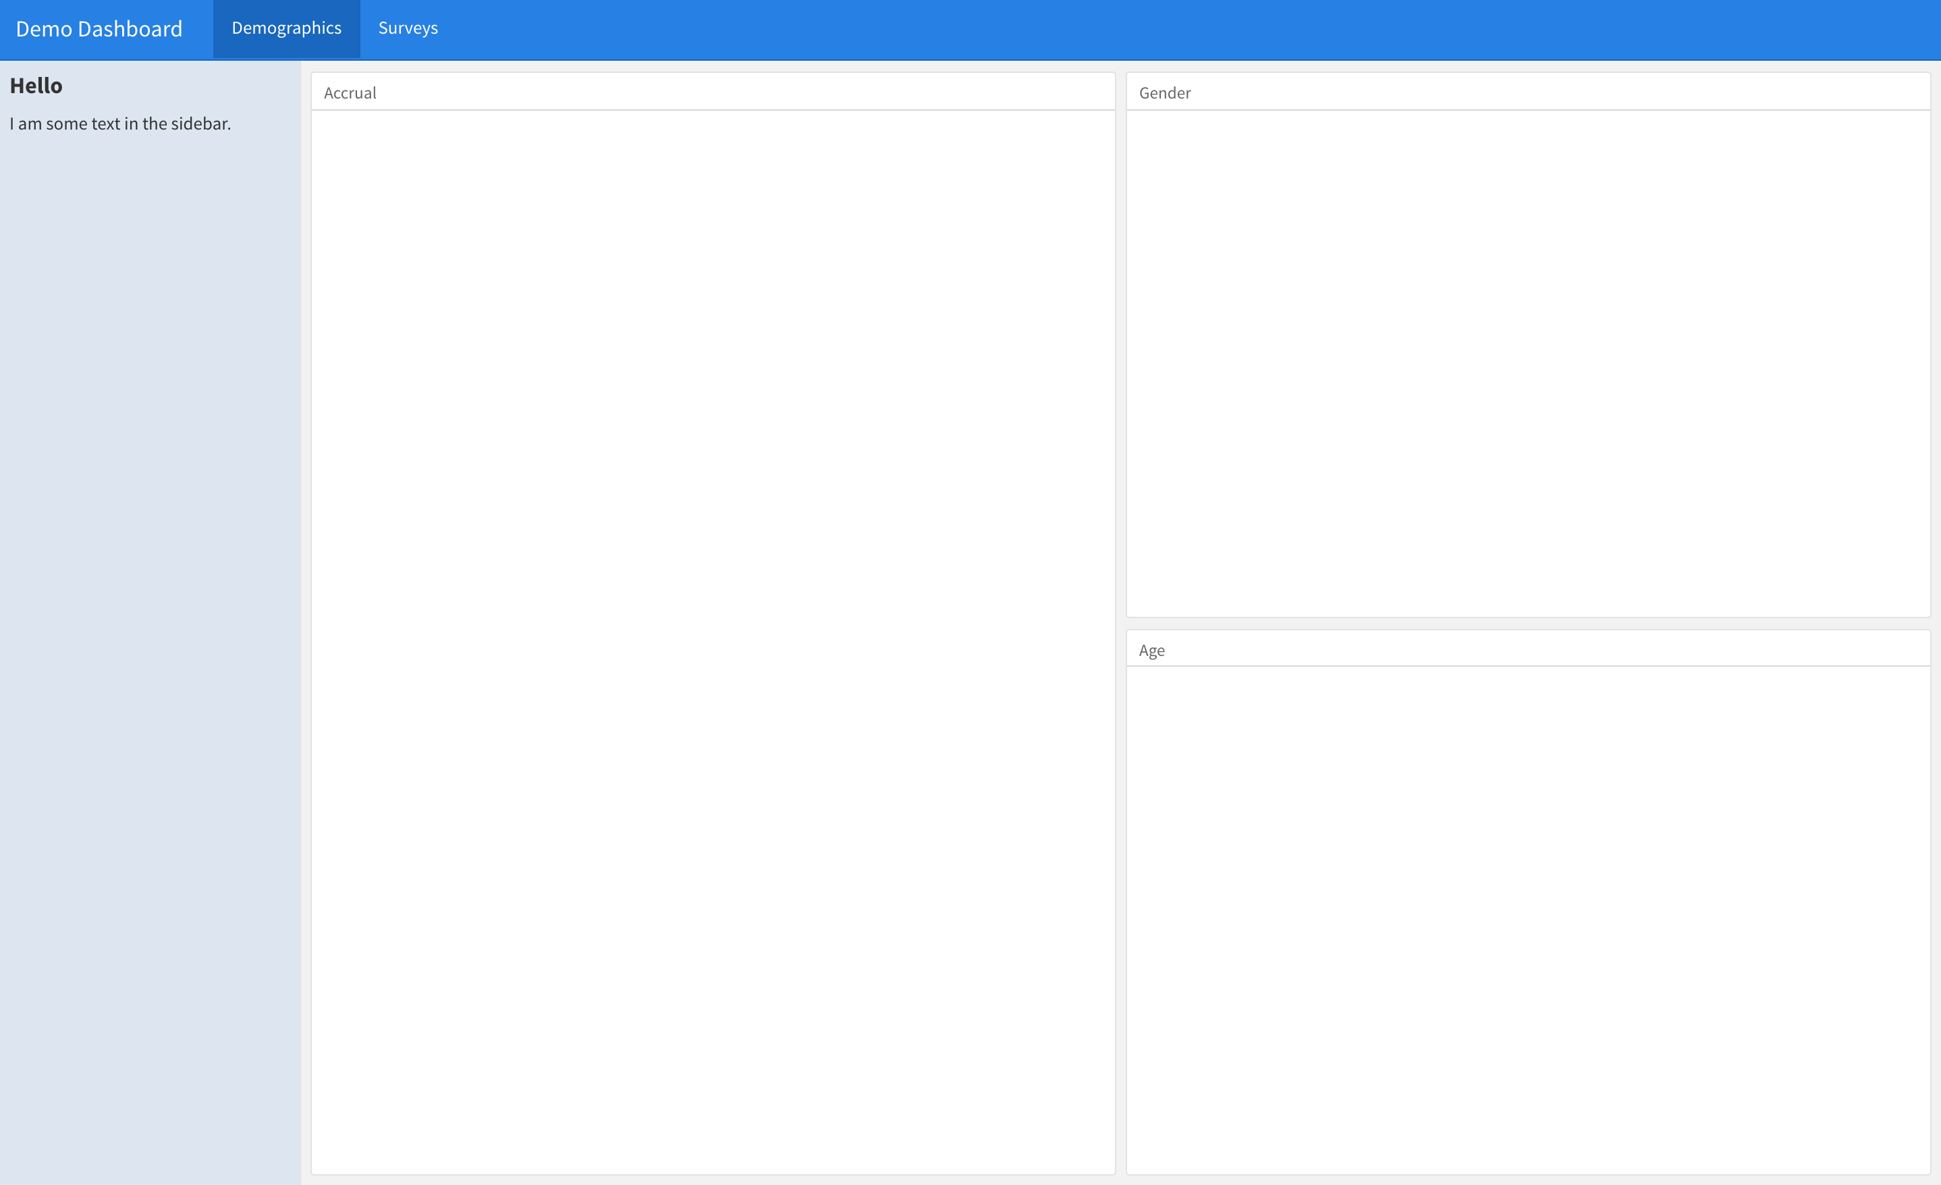

Slide 24
Deploy
Static Reports/Dashboards
Nothing additional required
Dynamic Dashboards
Needs to be hosted on a server with R installed
shinyapps.io – hosting service by Rstudio
Shiny Server – can be set up by your institution
RStudio Connect – full publishing platform from Rstudio
Share your code with someone else – requires that they have and can use R ☺

Slide 25
Demo
RMarkdown (plus Shiny)
Demo
Shiny Only
Data registry example
Notes:
best way to handle missing data is to stop it from being missing.

Slide 26
Discussion
Notes:
best way to handle missing data is to stop it from being missing.

Slide 27
Notes:
best way to handle missing data is to stop it from being missing.

Slide 28
Thank you!
Questions:
Michael Golafshar
golafshar.michael@mayo.edu

